Slide 1

HTML,CSS and Bootstrap
INTERNAL

Slide 2
Agenda
INTERNAL
Module 1: Web Fundamentals
Module 2: Introduction to HTML5 Module 3: What is CSS?
Module 4: Bootstrap Fundamentals
1

Slide 3
Web Fundamentals
INTERNAL
2

Slide 4

Web Designer
INTERNAL
Design the look and feel of a website (creative side of website)
Decides the layouts, fonts, colors, images etc.
Creates the visual mock-up of website
Rarely does the development of website
3

Slide 5

Web Programmer
INTERNAL
Brings the website mock-up to life on internet (development side of website)
Develops the website and host onto server.
Has web development skills: HTML, CSS, JavaScrip Java, NodeJS, ReactJS etc.
t,
4

Slide 6

INTERNAL
Web Site
A collection of web pages which are grouped together and usually connected in various ways like hyperlinks, buttons etc .
It creates first impression of your business
It can bring business from any part of the
world
It reflects your expertise and reputation.
5

Slide 7


Client Server 2 tier Web Architecture
INTERNAL
Typically, when you are browsing the Internet, you will be using Web Browser software such as Chrome, IE, Firefox etc. so computer which is running a browser is called
a client, while the machine which is providing Web pages is called a server.
3
A physical machine operates server
logic on the user’s request to
determine what to send back
1
User enters URL in the browser
2
HTTP request is
submitted to that URL’s
corresponding server
Client
User receives the response in the form of HTML pager which renders in the browser
Server
4
window
6
5

Slide 8
INTERNAL
Introduction to HTML
10

Slide 9
What is HTML
INTERNAL
HTML5 is the standard markup language for creating Web pages.
HTML stands for Hyper Text Markup Language
HTML describes the structure of Web pages using markup
HTML elements are represented by tags
HTML tags label pieces of content such as "heading", "paragraph", "table", and so on
Browsers do not display the HTML tags, but use them to render the content of the page

Slide 10
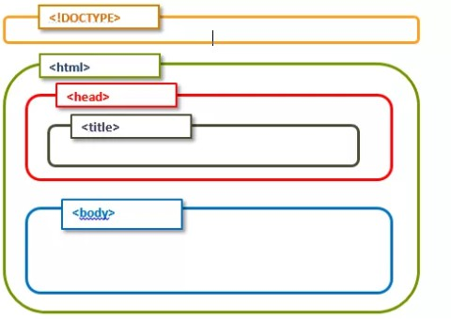
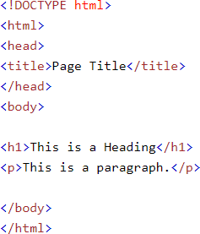
HTML5 Template
INTERNAL

Slide 11
Main categories of elements
INTERNAL
Block level elements : <div>, <p>,<h1> to <h6>, <form>, <table> etc.
Inline elements: <img>, <a>, <span>, <input> etc.

Slide 12

Attributes
INTERNAL
Attributes are something which give the additional information of the element. Ex. name, width, height, alt, title, id, class etc.
The id and class attributes: id attribute is used to uniquely identify any element and class is to create a group of elements.
Unique id attribute can be refereed to single person in a class but class attribute is going to be same for all persons belonging to the class.

Slide 13
Types of elements
INTERNAL
Empty elements (<br/>)
Nesting elements ( <p> This is my<b>element</b>)
Headings (h1 to h6)
Paragraphs (<p>)
Lists ( ordered (<ol>) and unordered (<ul>) )
Tables (<table>, <tr>, <td>, <th>)
Images (<img>)
Links (<a>)
Text formatting (<i>,<u>,<b>,<strong>,<em>)

Slide 14
List of elements contained inside a form
INTERNAL
Text Box (Single row)
Radio Button (Single selection)
Check Box (Multiple selection)
Drop down (Multiple selection)
Text area (Multiple rows)
Click button
Submit button
Reset button

Slide 15
Form elements
INTERNAL
S No. | Type | Code
1 | Text Box | <input type="text" name="name" value=“John"/>
2 | Radio Button | <input type="radio" name="gender" value="M">Male</input>
3 | CheckBox | <input type="checkbox" name="technology" value="Tech1">HTML</input>
4 | textarea | <textarea rows=“2” cols=“2” name="address"></textarea

Slide 16
Form elements cont…
INTERNAL
S No. | Type | Code
5 | Drop Down | <select name="cities"> <option value="BGL">Bangalore</option> <option value="MYR">Mysore</option </select>
6 | Click Button | <input type="button" value="Click Me"/>
7 | Submit button | <input type="Submit"/>
8 | Reset Button | <input type=“Reset"/>

Slide 17
Form attributes
INTERNAL
S No. | Type | Code
1 | size | Changes the width of textboxes
2 | maxlength | maximum no of chars entered in textbox
3 | minlength | minimum no of chars entered in textbox
4 | placeholder | display placeholder value
5 | checked | makes checkboxes or radio buttons to be checked by default
6 | selected | makes one option of dropdown selected by default

Slide 18
Form attributes cont…
INTERNAL
S No. | Type | Code
7 | multiple | allows to select multiple values from drop down
8 | readonly | data is going to be processed
9 | disabled | data is not going to be processed
10 | action | defines the action to be performed when the form is submitted and If the action attribute is omitted, the action is set to the current page.
11 | method | specifies the HTTP method (GET or POST) to be used when submitting the form data
12 | target | specifies if the submitted result will open in a new browser tab or in the current window.

Slide 19
get vs post
INTERNAL
Get | Post
Appends form-data into the URL in name/value pairs | The POST method does not display the submitted form data in the page address field.
The length of a URL is limited (about 3000 characters) | POST has no size limitations, and can be used to send large amounts of data.
Never use GET to send sensitive data! (will be visible in the URL) | Always use POST if the form data contains sensitive or personal information.
Useful for form submissions where a user want to bookmark the result | Form submissions with POST cannot be bookmarked
GET is better for non-secure data, like query strings in Google | POST is better for secure data, like password

Slide 20
HTML5 Forms – Input Types
INTERNAL
S No. | Type | Description
1 | color | used for input fields that should contain a color.
2 | date | used for input fields that should contain a date.
3 | datetime-local | specifies a date and time input field, with no time zone.
4 | time | allows the user to select a time (no time zone).

Slide 21
HTML5 Forms – Input Types cont…
INTERNAL
S No. | Type | Description
5 | week | allows the user to select a week and year.
6 | month | allows the user to select a month and year.
7 | email | used for input fields that should contain an e-mail address.
8 | number | defines a numeric input field.
9 | range | defines a control for entering a number whose exact value is not important (like a slider control). Default range is 0 to 100. However, you can set restrictions on what numbers are accepted with the min, max, and step attributes.

Slide 22
HTML5 Forms – Attributes
INTERNAL
S No. | Type | Description
1 | autofocus | specifies that the input field should automatically get focus when the page loads.
2 | autocomplete | When autocomplete is on, the browser automatically completes the input values based on values that the user has entered before.
3 | placeholder | specifies a hint that describes the expected value of an input field (a sample value or a short description of the format).
4 | required | specifies that an input field must be filled out before submitting the form.
5 | pattern | specifies a regular expression that the <input> element's value is checked against before submitting form

Slide 23
HTML5 Forms – Attributes Cont…
INTERNAL
S No. | Type | Code
6 | multiple | specifies that the user is allowed to enter more than one value in the <input> element. The multiple attribute works with the following input types: email, and file.
7 | list | refers to a <datalist> element that contains pre-defined options for an <input> element.
8 | height and width attributes | specify the height and width of an <input type="image"> element.
9 | step | specifies the legal number intervals for an <input> element.
10 | min and max | specify the minimum and maximum values for an <input> element.

Slide 24
HTML5 forms - Pattern attribute
INTERNAL
Specifies a regular expression that the input value is checked against before submitting the form.
Example 1: Entered name can only have alphabets. pattern= “[A-Za-z]+”
Example 2: Entered phone no can only have numbers of 10 digits. pattern =“[7-9]{1}[0-9]{9}”

Slide 25
HTML5 Forms – Pattern Attribute
INTERNAL
S No. | Type | Code
1 | [0-9] | Find any of the digits between the brackets
2 | [a-z] | Find any of the characters between the brackets
3 | [0-9a-z] | Find any of the alphanumeric characters (small letters)between the brackets
4 | [0-9a-zA-Z] | Find any of the alphanumeric characters between the brackets
5 | [abc] | Find any of the characters between the brackets
6 | [0-9*$] | Find any of the digits and special chars (*$)between the brackets

Slide 26
HTML5 Forms – pattern quantifiers
INTERNAL
S. No. | Type | Description
1 | [0-9]+ | Matches any string that contains at least one digit
2 | [0-9]* | Matches any string that contains zero or more occurrences of n
3 | [0-9]? | Matches any string that contains zero or one occurrences of n
4 | [0-9]{3} | Matches any string that contains exactly 3 occurrences of n
5 | [0-9]{3,} | Matches any string that contains minimum 3 occurrences of n
6 | [0-9]{3,6} | Matches any string that contains minimum 3 occurrences of n and max 6 occurrences

Slide 27
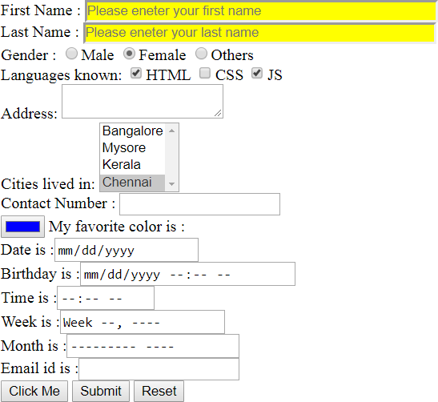
INTERNAL
Hands-on for forms
Design the page using HTML5.
Validate first name (only alphabets), last name (only alphabets), contact number(10 digits) and email-id.
Make sure all the fields are
required.
Once user submits the page, the new page should open
saying “Welcome User”. Try http
method as get and post also

Slide 28
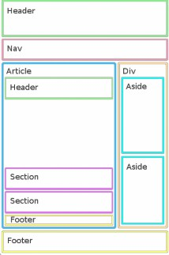
INTERNAL
HTML5 Semantic elements
Semantic elements = elements with a meaning.
<article>
<aside>
<details>
<figcaption>
<figure>
<footer>
<header>
<main>
<mark>
<nav>
<section>
<summary>
<time>

Slide 29
INTERNAL
What is CSS?
31

Slide 30
INTERNAL
What is CSS
CSS stands for Cascading Style Sheets
CSS describes how HTML elements are to be displayed on screen, paper, or
in other media
CSS saves a lot of work. It can control the layout of multiple web pages all at once
External stylesheets are stored in CSS files
32

Slide 31
Selectors
INTERNAL
Selectors are something using which we can select the HTML elements. Below are different types of selectors.
Syntax:
selector { Property: value; }
Example:
Element Selector : p {color:red;}
Class Selector : .c1{color:red;}
Id Selector : #id1{color:red;}
Universal Selector : # {color:red;}

Slide 32
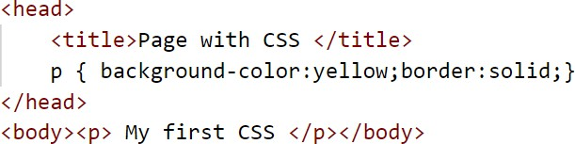
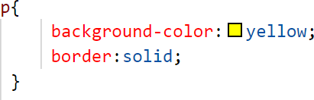
INTERNAL
Types of Styling
Inline Styling are CSS declarations that affect one element only, contained within a style attribute.
Internal Styling is where you don't have an external CSS file, but instead place your CSS inside
a <style> element, contained inside
the HTML head.
An external stylesheet is when you have your CSS written in a separate file with a .css extension, and you reference it from an
HTML <link> element.

Slide 33

CSS Box Model
INTERNAL
All HTML elements can be considered as boxes. In CSS, the term "box model" is used when talking about design and layout.

Slide 34
INTERNAL
Font property
The CSS font properties define the font family, boldness, size, and the style of a text.
font-family: "Times New Roman", Times, serif;
font-style : normal| italic| oblique;
font-size: 10px| 10%;
font-weight: normal | bold| 100-900;
font-variant: normal | small-caps;

Slide 35

INTERNAL
Border property
The CSS border properties allow you to specify the style, width, and color of an element's border.
CSS border properties:
border-width: 2px;
border-style: solid;
border-color: red;

Slide 36
INTERNAL
Display property
The display property is the most important CSS property for controlling layout. The display property specifies if/how an element is displayed.
The possible values of display are:
Inline
block
none
inline-block

Slide 37
The position property specifies the type of positioning method used for an element. Elements are then positioned using the top, bottom, left, and right properties. However, these properties will not work unless the position property is set first.
INTERNAL
Position property
There are four different position values:
Static (default)
Relative
Fixed
Absolute

Slide 38
INTERNAL
Combinators
A combinator is something that explains the relationship between the selectors.
A CSS selector can contain more than one simple selector. Between the
simple selectors, we can include a combinator.
There are four different combinators in CSS:
descendant selector (space) : div p {}
child selector (>): div >p { }
adjacent sibling selector (+): div+p {}
general sibling selector (~): div~p {}

Slide 39
Bootstrap fundamentals
INTERNAL
41

Slide 40

Responsive web design is about creating web sites which automatically adjust themselves to look good on all devices, from small phones to large desktops.
Example: www.getbootstrap.com
INTERNAL
What is Responsive web design

Slide 41
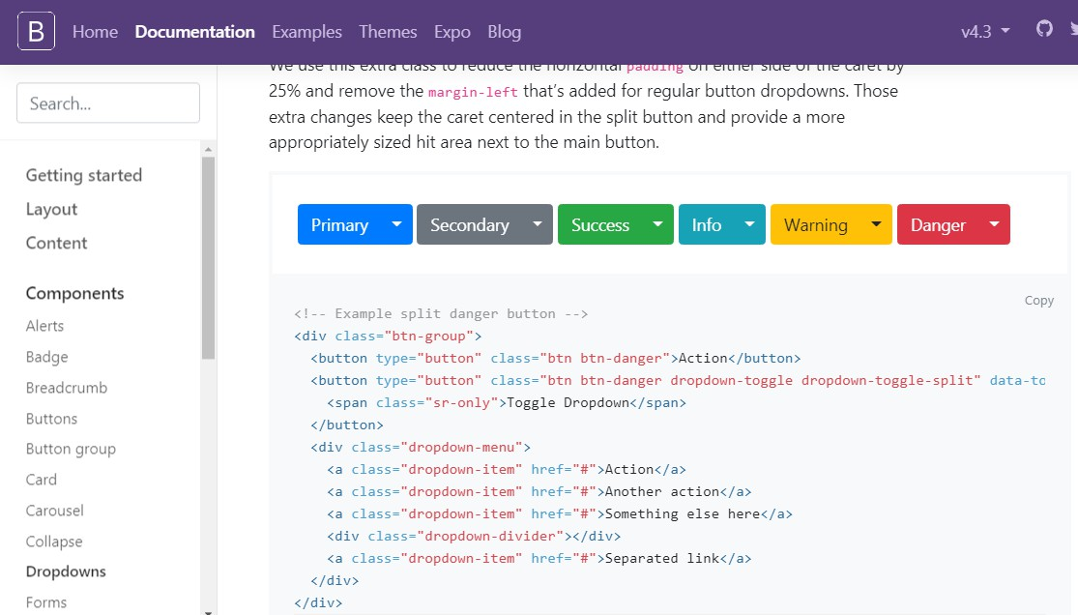
INTERNAL
What is Bootstrap
Bootstrap is an open source front-end framework developed by Twitter for faster and easier web development
Bootstrap includes HTML and CSS based design templates for typography, forms, buttons, tables, navigation, modals, image carousels, dropdown and many other, as well as optional JavaScript plugins.
Bootstrap also gives you the ability to easily
create responsive designs
Current version of Bootstrap is 4.3.1 released on February 2019.
Official website is http://getbootstrap.com

Slide 42
INTERNAL
Advantages of Bootstrap
Easy to use: Anybody with just basic knowledge of HTML and CSS can start using
Bootstrap
Responsive features: Bootstrap's responsive CSS adjusts to phones, tablets, and desktops
Mobile-first approach: Bootstrap 3 onwards mobile-first styles are part of the core framework
Browser compatibility: Bootstrap is compatible with all modern browsers (Chrome,
Firefox, Internet Explorer, Edge, Safari, and Opera)

Slide 43
INTERNAL
Prerequisite
There are three ways to start using Bootstrap on your own web site:
Download Bootstrap from getbootstrap.com
Download using NPM
Include Bootstrap from a CDN (Content Delivery Network)

Slide 44
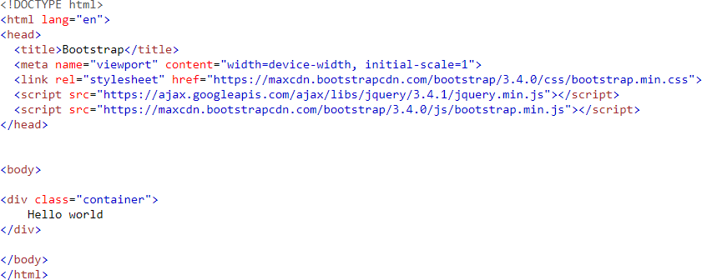

Hello World page using Bootstrap
INTERNAL

Slide 45
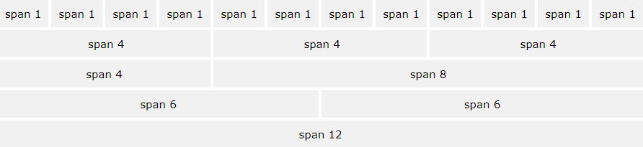
INTERNAL
Bootstrap Grid System
Bootstrap's grid system allows up to 12 columns across the page.
Bootstrap's grid system is responsive, and the columns will re-arrange depending
on the screen size.

Slide 46
INTERNAL
Grid System Classes
The Bootstrap 3 grid system has four classes:
Class | Device | Width
.col-sm | Phones | width<768px
.col-md | Laptops | 768px<= width<992px
.col-lg | Desktops | 992px<=width<1200 px
.col-xl | Smart TV | width >=1200px
The classes above can be combined to create more dynamic and flexible layouts. Tip: Each class scales up, so if you wish to set the same widths for sm and md, you only need to specify sm.

Slide 47
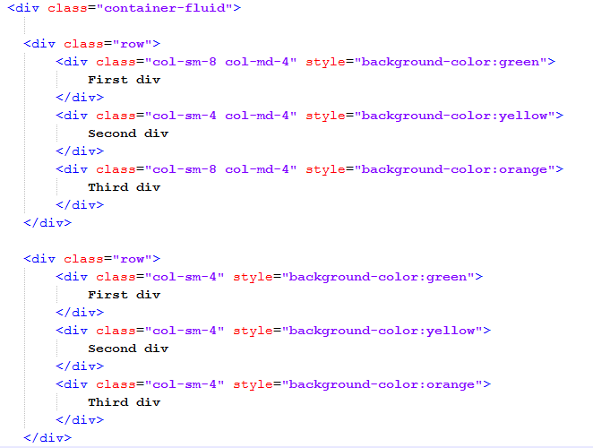
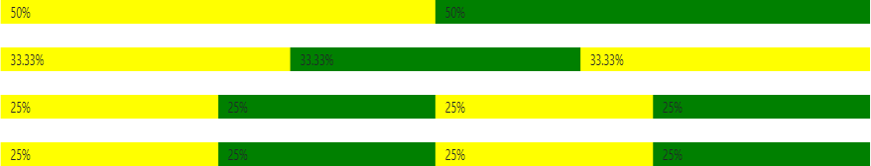
Basic Grid Structure
INTERNAL

Slide 48
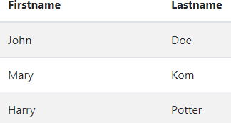
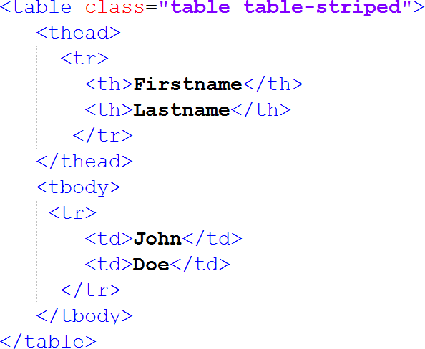
INTERNAL
Table
The .table class adds basic styling to a table: A basic Bootstrap table has a light padding and only horizontal dividers.
The .table-striped class adds zebra-stripes to a table.
The .table-bordered class adds borders on all sides of
the table and cells.
The .table-hover class adds a hover effect (grey background color) on table rows.
The .table-condensed class makes a table more
compact by cutting cell padding in half.

Slide 49

INTERNAL
Buttons
To achieve the different background color for button, Bootstrap has the following classes.
.btn
.btn-default
.btn-primary
.btn-success
.btn-info
.btn-warning
.btn-danger
.btn-link
Bootstrap provides different button sizes. The classes that define the different sizes are:
.btn-lg
.btn-md
.btn-sm
.btn-xs

Slide 50
INTERNAL
Bootstrap Forms
Bootstrap provides three types of form layouts:
Vertical form (this is default)
Horizontal form
Inline form
Standard rules for all three form layouts:
Wrap labels and form controls in <div class="form-group"> (needed for optimum
spacing)
Add class .form-control to all textual <input>, <textarea>, and <select>elements
All textual <input>, <textarea>, and <select> elements with class .form-control have a width of 100%.

Slide 51
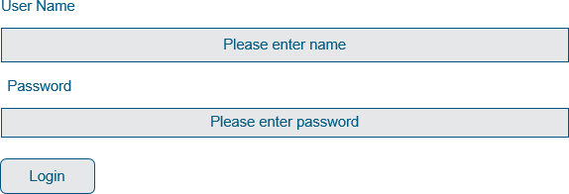
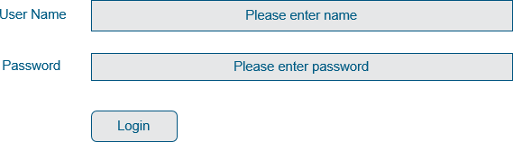
Types of Bootstrap Forms
INTERNAL
Vertical Form (default)
Inline Form
Horizontal Form

Slide 52
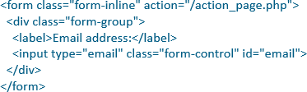
Bootstrap Inline Forms
In an inline form, all of the elements are inline, left-aligned, and the labels are alongside.
Note: This only applies to forms within
viewports that are at least 768px wide!
Additional rule for an inline form:
Add class .form-inline to
the <form> element

Slide 53
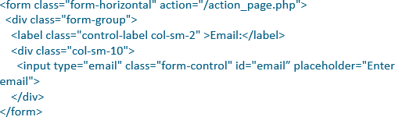
Bootstrap Horizontal Forms
A horizontal form means that the labels are aligned next to the input field (horizontal) on large and medium screens. On small screens (767px and below), it will transform to a vertical form (labels are placed on top of each input).
Additional rules for a horizontal form:
Add class .form-horizontal to the <form> element
Add class .control-label to all <label> elements

Slide 54
Enhance web page using bootstrap
56

Slide 55
Thank You
INTERNAL
59

